Slide 1
Covid-19 in india
No Prognosis is the only possible prognosis

Slide 2
Covid in India: Methodology
SIR models
SIR models are restrictive; cannot factor in too many imponderables; difficult to take into account policy and individual response
Stochastic Individual Contact Models
Insightful to understand the trajectory of the infection

Slide 3
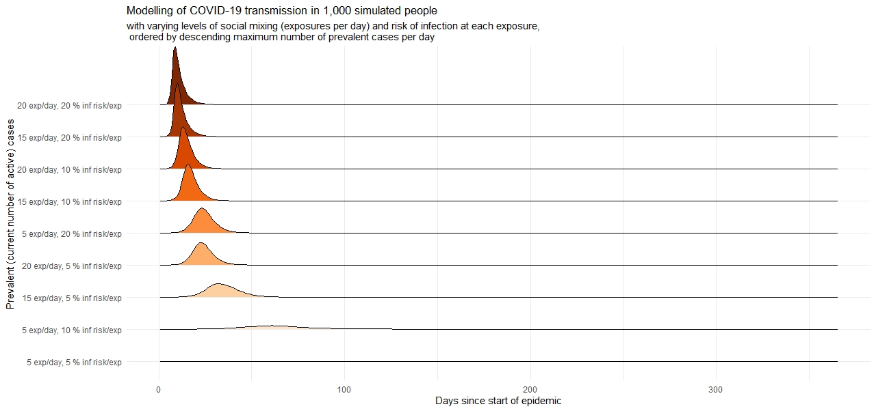

Slide 4
1. Began in large overcrowded, economically dynamic metros, outward migration a rational response but carried infections to areas not well suited to cope
2. Spread from slums to high rises, from cities to rural areas
3. Two metrics; R and doubling period , methodologies for calculating

Slide 5
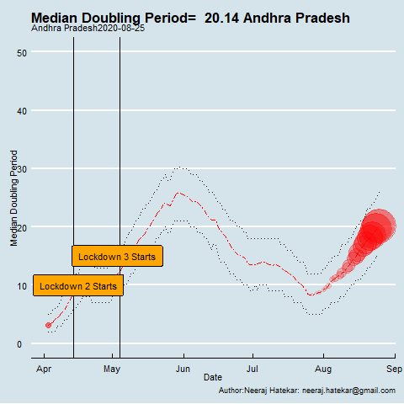
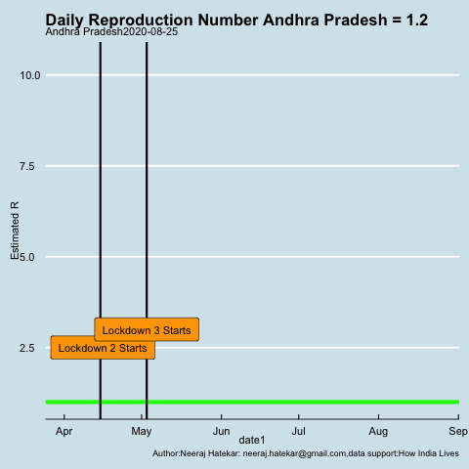

Slide 6
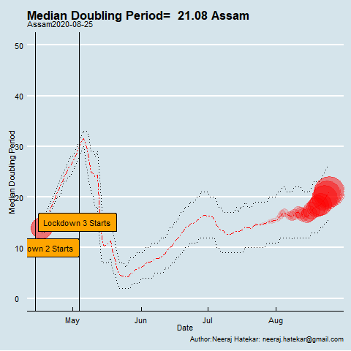
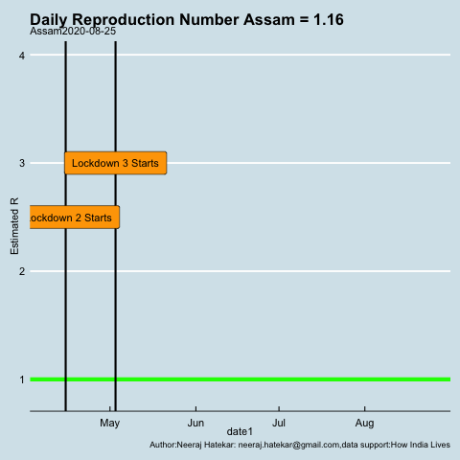

Slide 7
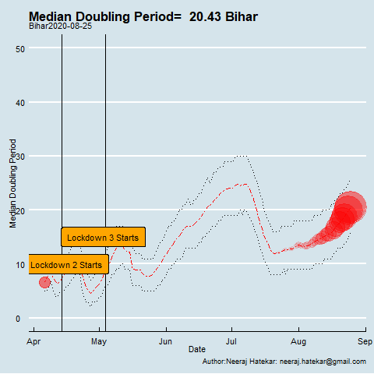
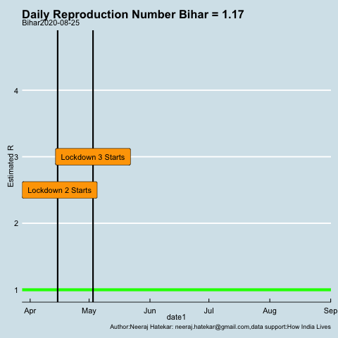

Slide 8
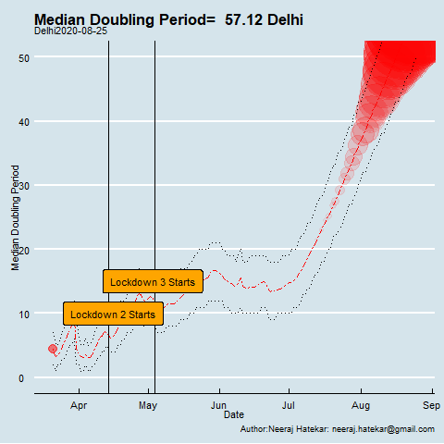
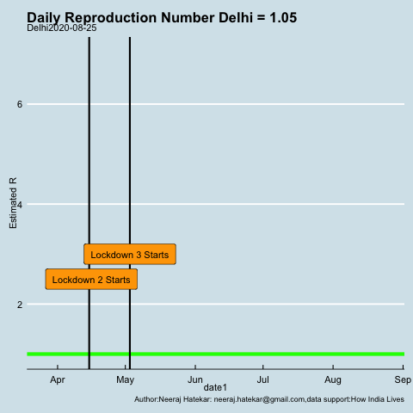

Slide 9
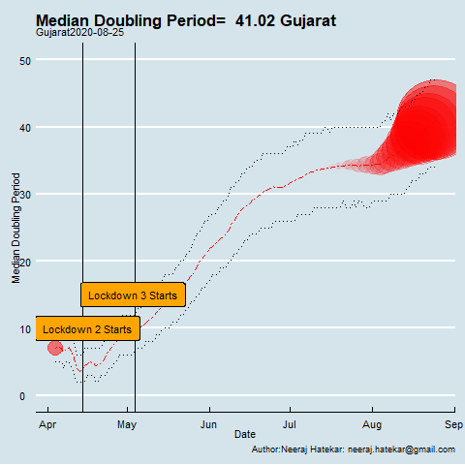
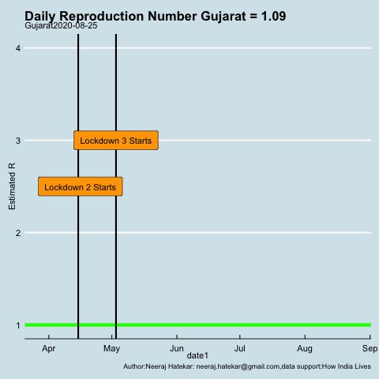

Slide 10
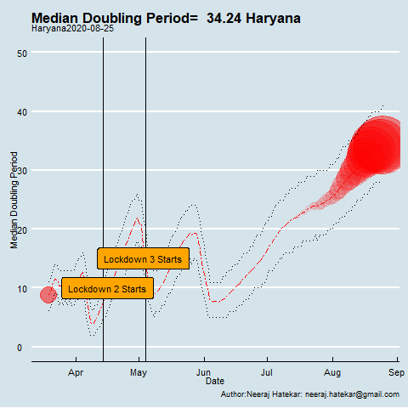
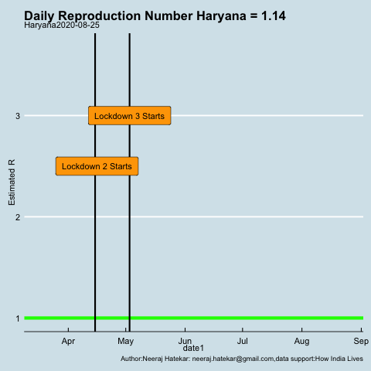

Slide 11
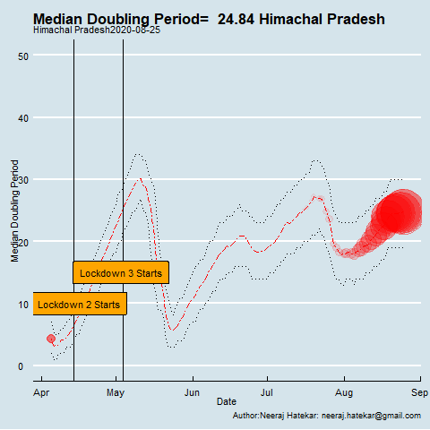
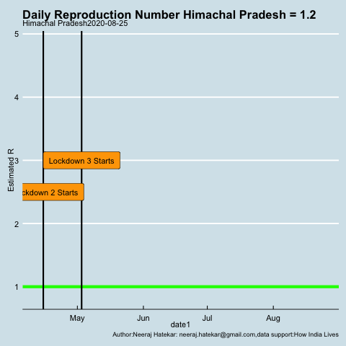

Slide 12
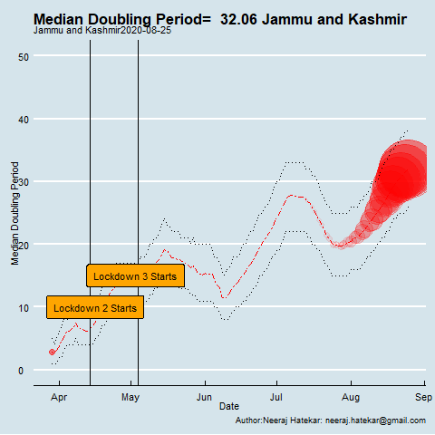
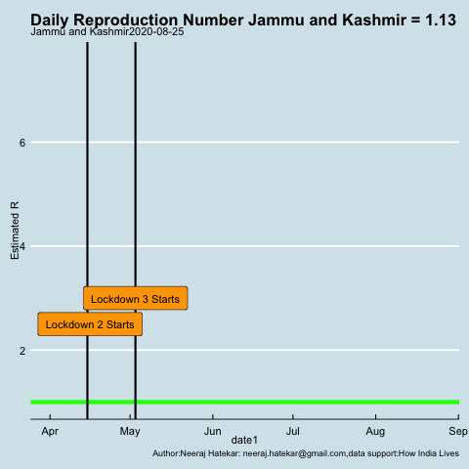

Slide 13
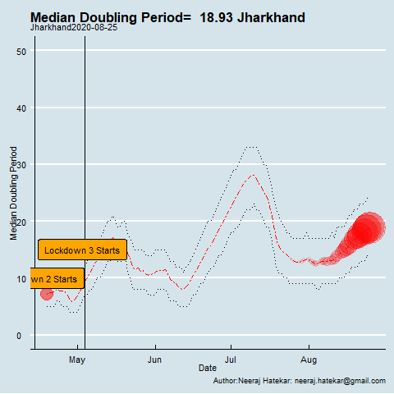
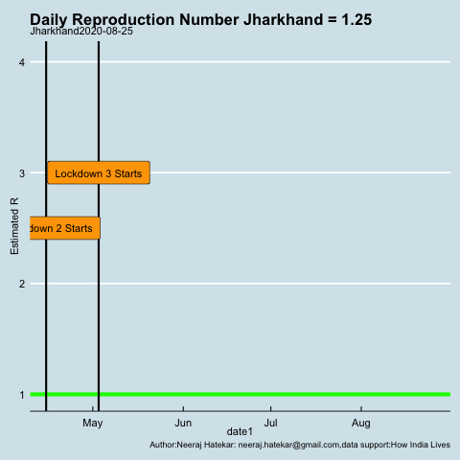

Slide 14
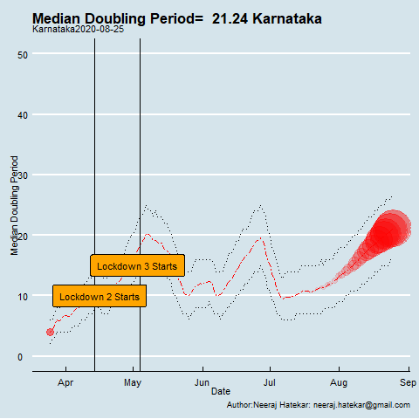
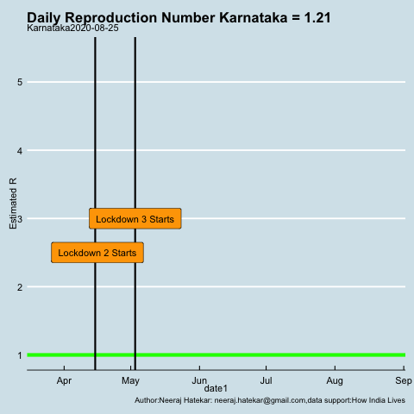

Slide 15
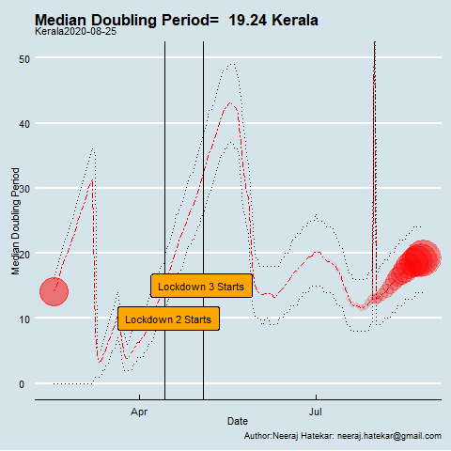
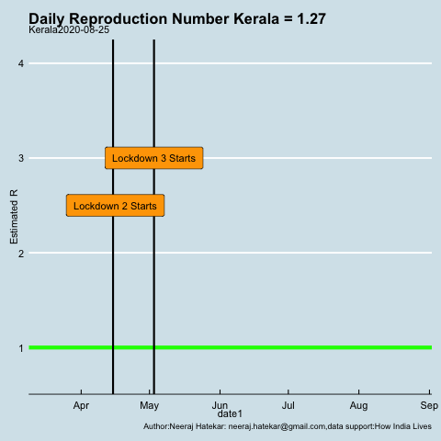

Slide 16
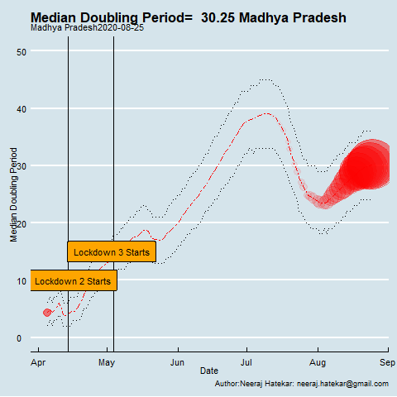
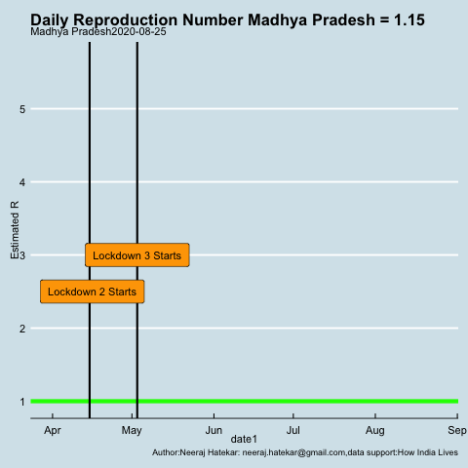

Slide 17
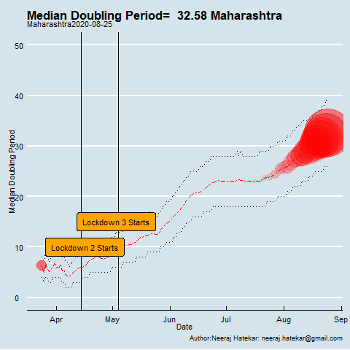
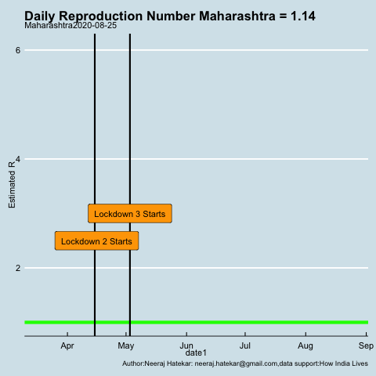

Slide 18
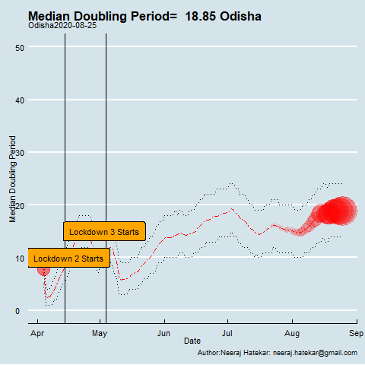
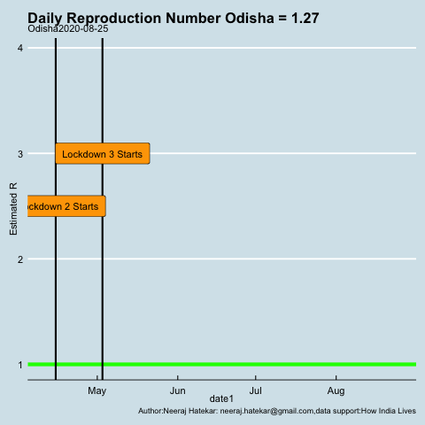

Slide 19
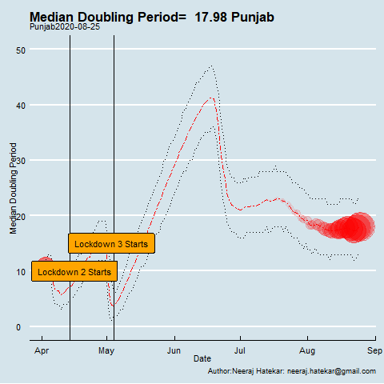
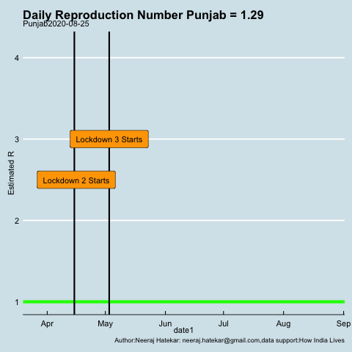

Slide 20
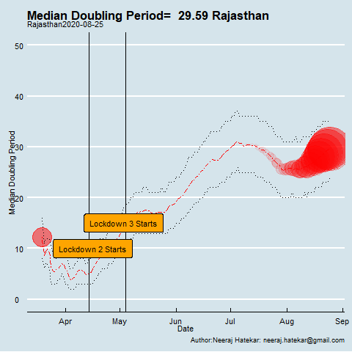
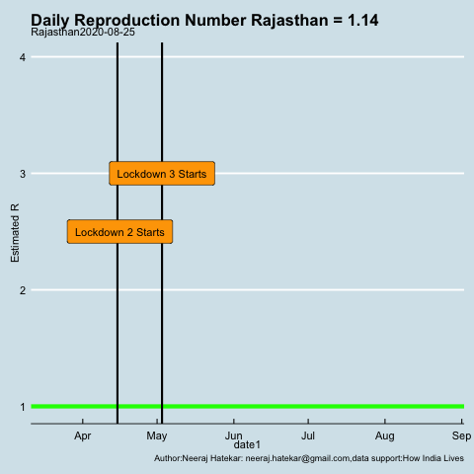

Slide 21
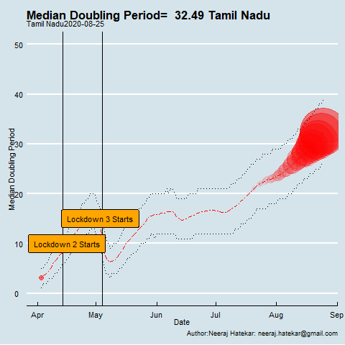
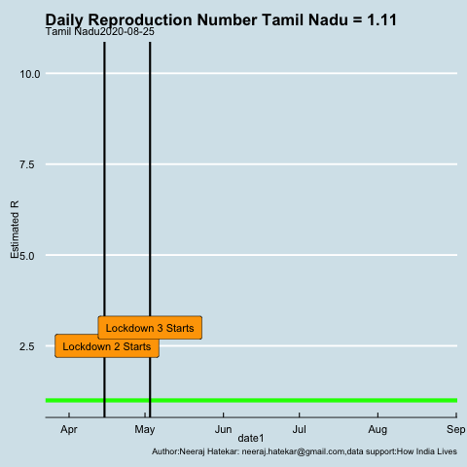

Slide 22
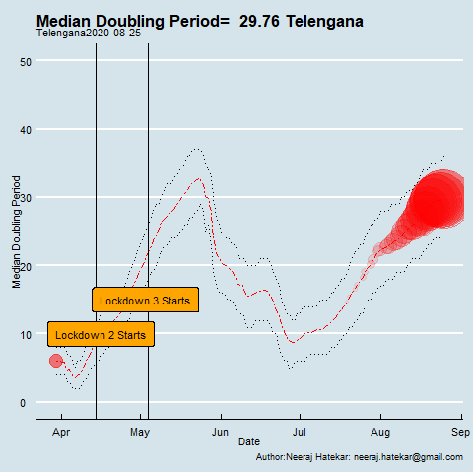
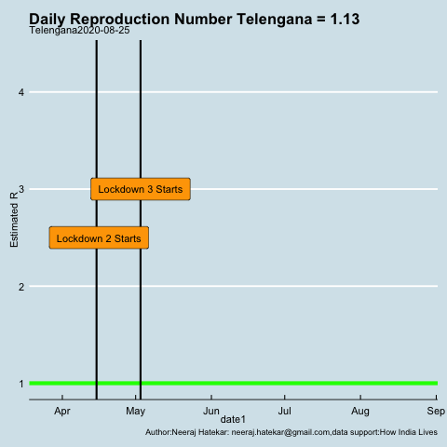

Slide 23
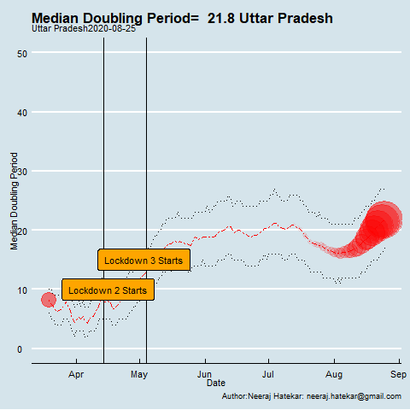
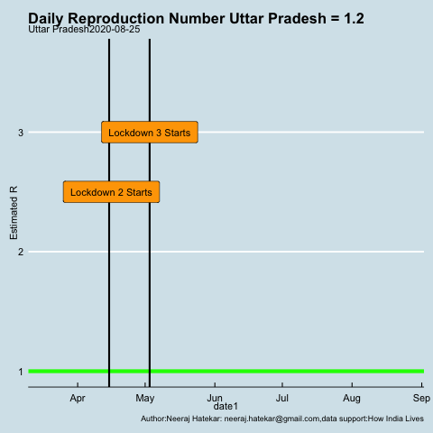

Slide 24
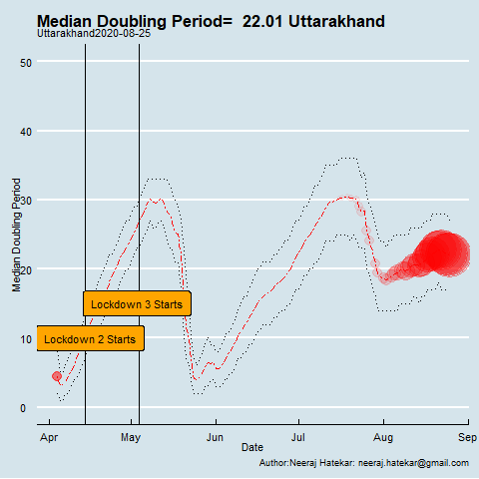
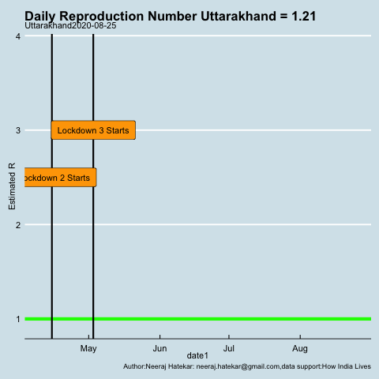

Slide 25
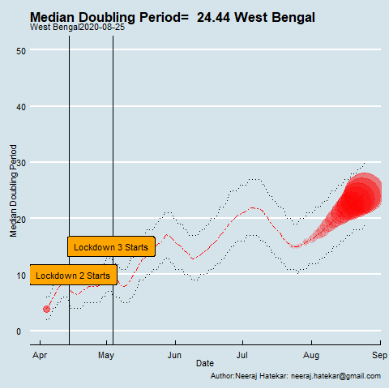
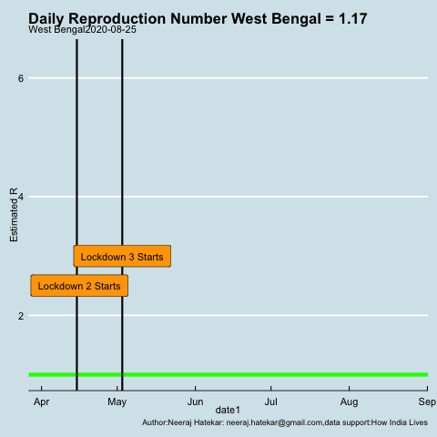

Slide 26
So, what is the prognosis: Not out of the woods , no ideas when
When it started, it was the disease of the wealthier regions,now, we have multiple stages; need more localized solutions to deal with the geographically diverse situations
Southern states with high human capital and income levels seem to have fared badly; there is no “model” for permanent victory, have to play it ball by ball..
Cooling down in large metros mainly because of large scale infections , second waves possible because of uncertain immune response
Covid seems to have cooled down in the wealthier geographies while poorer states are under relatively weaker control
In metros like Mumbai, despite cases stabilizing, death rates are not under control; Barker thesis, migration
Second waves already formed or forming in some parts
State resources already weak, might not be able to sustain a continuous state of highest alertness

Slide 27
Impact
Small and micro enterprise impacted strongly because of lock downs
Strong demand side effects will discourage investment ; animal spirits
Agriculture will also feel the pinch through lower demand
Large employment impact on the unorganized sector
Cost of doing business will be substantially higher
Urban and rural poor particularly hit
Large demand side interventions required; resources are a problem
We are in it for the long haul, markets will reflect that soon….
Cannot continue with lockdowns indefinitely, need to think of alternatives to resume normal economic activity
Need to start to rebuild from the bottom of the pyramid

